Slide 1
Computer Vision
Course Project
OCR~Mouse : A Multi-CV Approach
A Project Submitted For Partial Fulfilment for Course CAP-5415
GIRISH KUMAR KANNAN
UCF ID : 4196719
Fall ’17 - University of Central Florida

Slide 2
Purpose
This project deals with the use of Computer Vision for Text Recognition and making use of real-time object tracking using live video feed from webcam.
This project shows the ability of computer vision technique to transcode a textual picture to a text string and the ability to track a moving object in real-time.
This is a combination of Three mini-projects.
Text OCR and Translation
Card Number OCR
Real-Time Mouse Pointer Functions by Tracking a Colored Object

Slide 3
Motivation
What if one can just wave their hand to point at an interface in a Computer?
Instead of using the mouse to point at the things.
I do not remember my credit/debit card number, also do not wish to enter every time I am asked for, can this be made easier?
Card OCR - Copy to Clipboard.
I saw a word of another language, I do not know how to type it, how do I know what it translates to?
Text OCR Translation

Slide 4
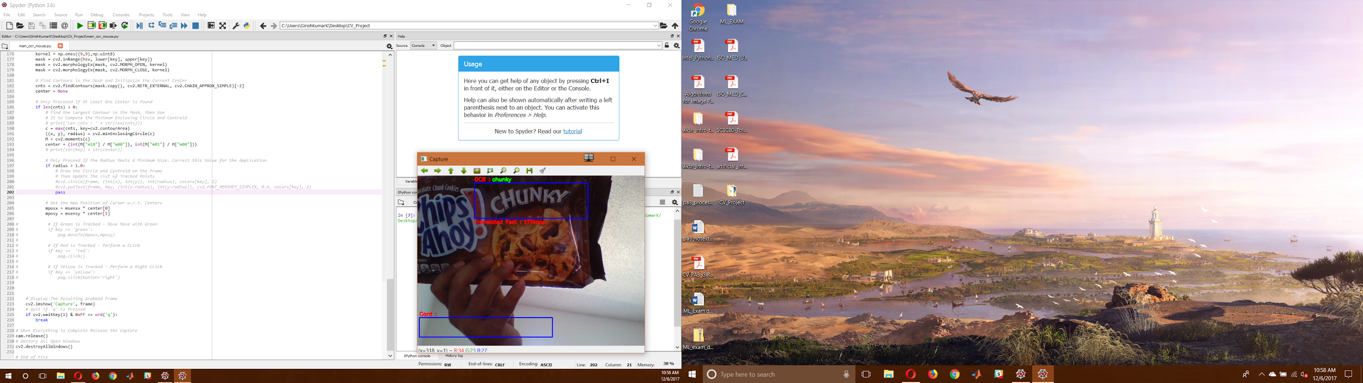
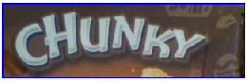

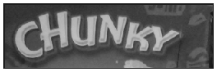

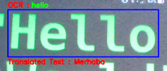


Text OCR Translate
Color Image
DeSkewed Image
Gray Image
Dilated Image
Thresholded Image
Eroded Image

Slide 5
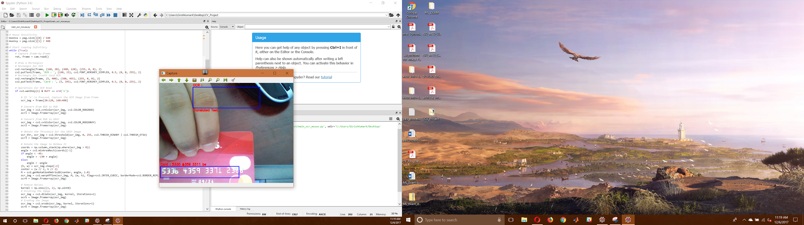
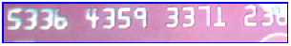

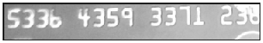



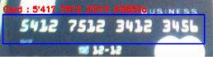


Card Number OCR
Color Image
Histogram Equalization
Gray Image
Dilated Image
Match : 9/14 = 64%
Color Inverted Image
Eroded Image
5330 #359 3311 be
Match : 11/16 = 69%
Thresholded Image
DeSkewed Image
5’41? 7512 3’01? 3’055?a

Slide 6
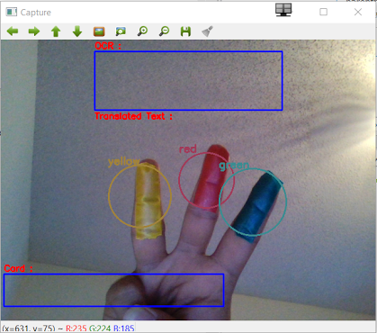
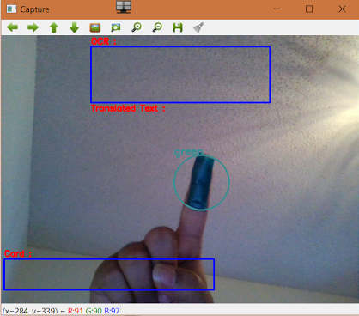
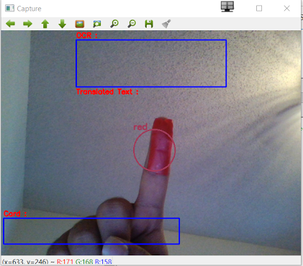
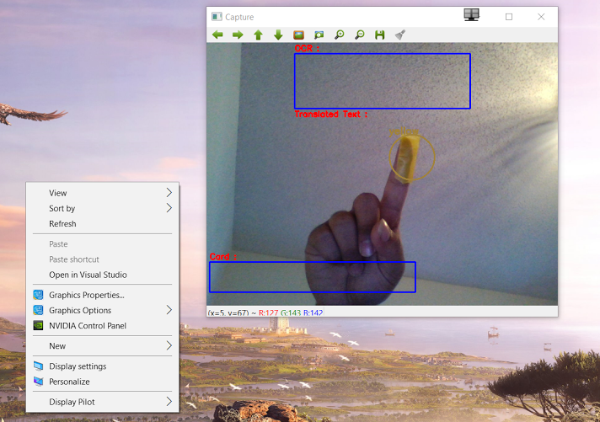
Color Tracked Mouse Functions
Move Mouse
Left Click Mouse
Right Click Mouse

Slide 7
Main Findings
The Lighting on the Subject has a key role
The Subject itself (its look and design) also plays a key role
Based on Object Tracked and Motion Detected, anything can be automated programmatically.
Too much processing cannot be done in a single frame in real-time.
OCR Translation - No.of Process and Time must be considered for faster output.
OCR Card Number - Latest card models do not use the old OCR fonts to match and recognize, so new method had to be chosen.
The tracking direction in laterally inverted, i.e, left and right are interchanged.

Slide 8
Approach / Solution
OCR - Translation and Card Number :
Obtain the Image from Frame and convert to Grayscale
Perform basic Operations like Thresholding, Inverting
DeSkew the Image to Straighten any Angled Texts
Remove Noise by Dilations and Erosions
Object Tracking - Mouse :
Define the required colors in HSV Space and fine tune them to suit
Obtain the Mask for every color detected and obtain the contours
To locate the colored object, get the largest contour and enclose a shape.
If the correct color is detected - perform the relevant mouse functions.

Slide 9
Difficulties
Could not make use of user-defined CV functions in real-time processing. Takes extra time and starts to lag. Built-in functions are faster than user-defined functions.
Could not Adaptively change a specific color. Had to threshold color sample for different lighting conditions / time of day.
Tuning for a specific color took a while. If a broad range is given, unwanted shades are detected as reference shades.
OCR : Background could not be deleted. Since Subject changes overtime, deletion of background sometimes deleted the subject foreground.
There is a lag when too much processing is done on one frame during live video capture.

Slide 10
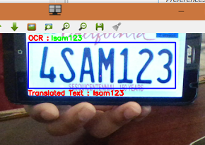
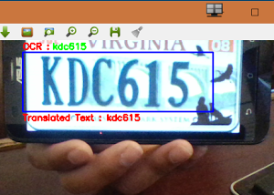
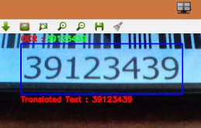
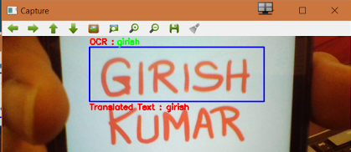
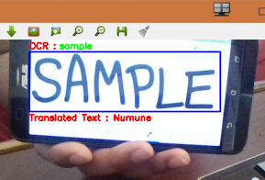
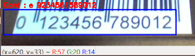
Other Results
e 9234561589012

Slide 11
Conclusion / Future Improvements
Conclusion : The Objective of implementing OCR and Object Tracking was implemented successfully, however, the results are just satisfactory and not so accurate.
Future Improvements :
Assisted Adaptive Color Identification and Tuning (click color to track it).
Better OCR with implementation of trained neural network models.
All-in-One multi purpose CV algorithms (scan to get result).
Hand and Fingers detection for moving mouse instead of colors.
Better algorithm for OCR Card Number (just to get the number).
Faster detection rate.
Cursive Handwriting OCR

Slide 12
Thank You !
Any Questions?

